Slide 1
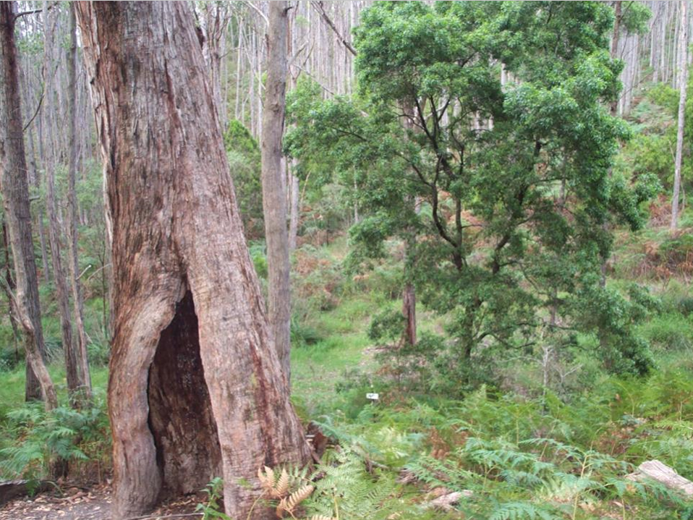
ARBURY PARK OUTDOOR SCHOOL
Making connections with our environment
Living and learning together
Bridgewater, South Australia www.arburypark.sa.edu.au

Slide 2
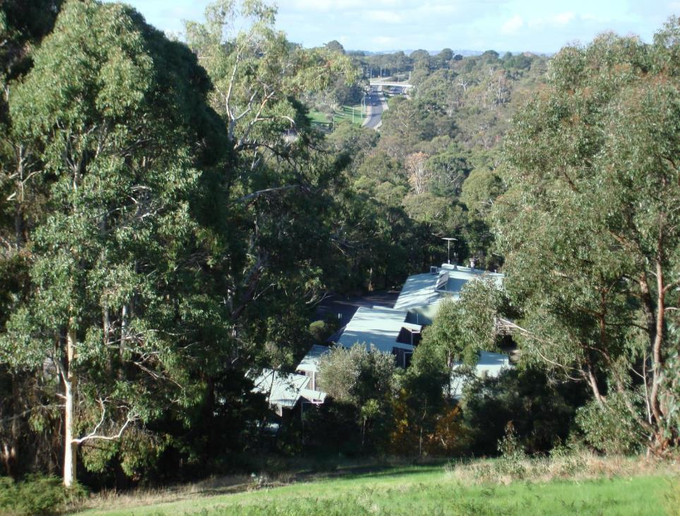
Arbury Park Outdoor School is a purpose built residential facility, situated on 32 hectares near Bridgewater in the Mt Lofty Ranges,
23 km from Adelaide. It is a state-wide service of the Department for Education that commenced operation in March 1976.

Slide 3
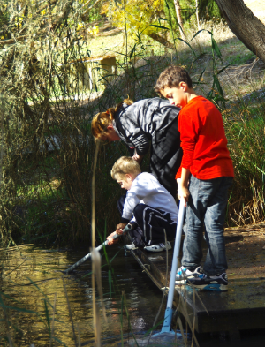
Learning in the outdoors
Learning at Arbury Park is guided by our three core values:
CURIOSITY is an eagerness to discover new things, to wonder and to learn. When we are curious we explore the mysteries of our world.
COMMUNITY is about the connections in our lives; connections between each other, with places and with things. Our community is the web of our relationships. It gives us a sense of belonging.
CARE means giving love and attention to people and things that matter. When we care about something or someone we try to give our best.

Slide 4
Dormitories sleep up to 16 people in double bunks.

Slide 5
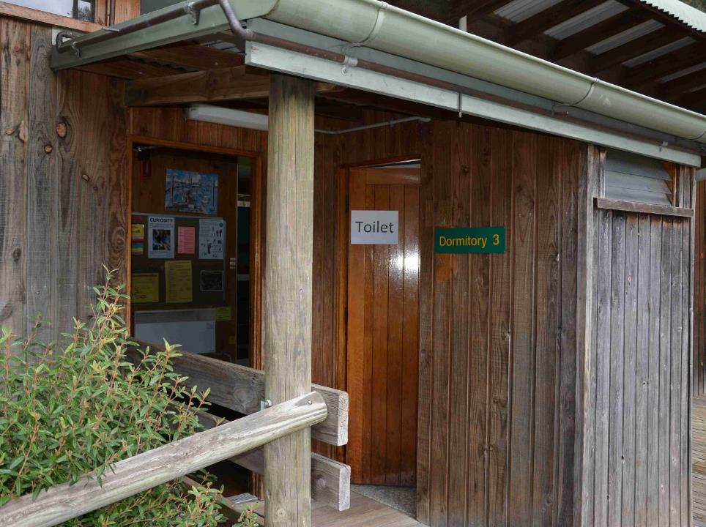
Each dormitory has a toilet.

Slide 6
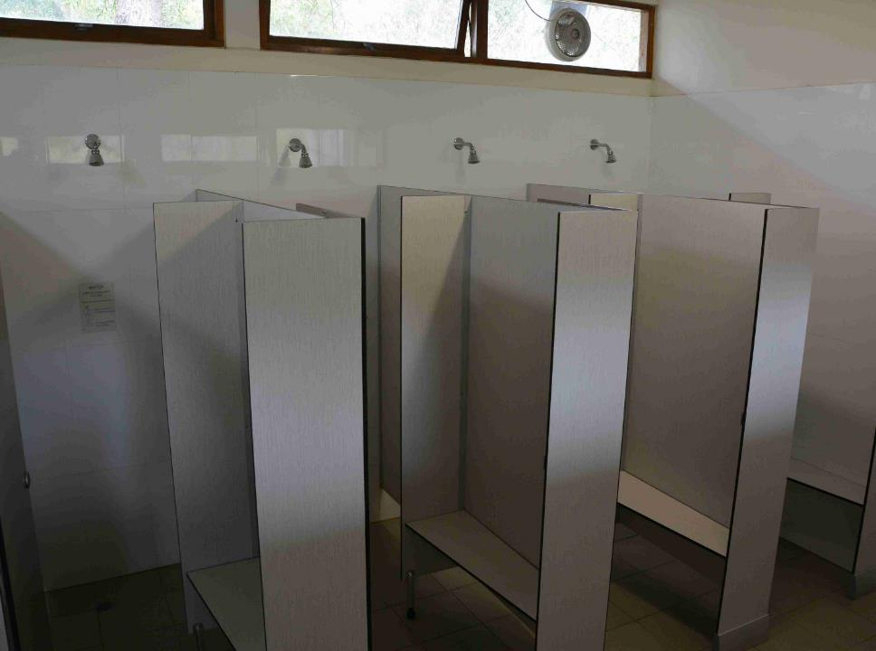
Male and female shower blocks each have five individual shower cubicles.

Slide 7
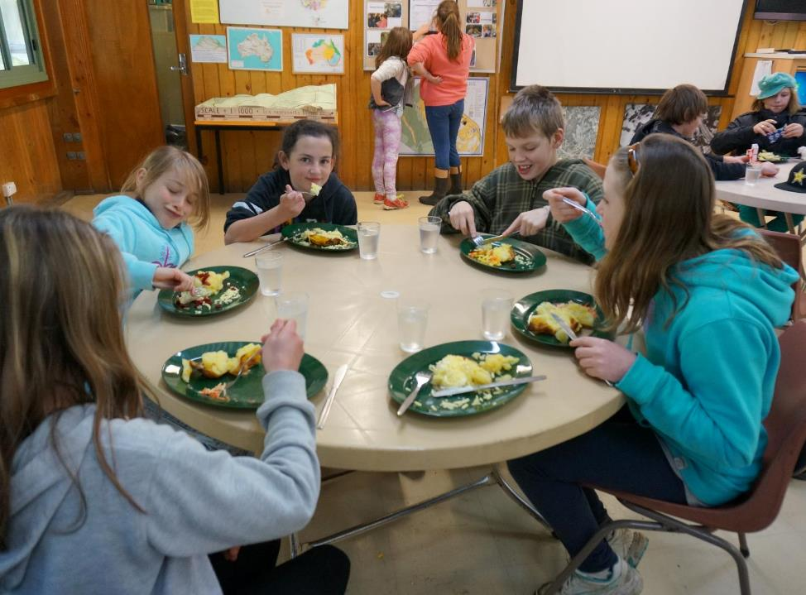
The dining room caters for up to 100 people at a time. Trained catering staff prepare special diets on request.

Slide 8
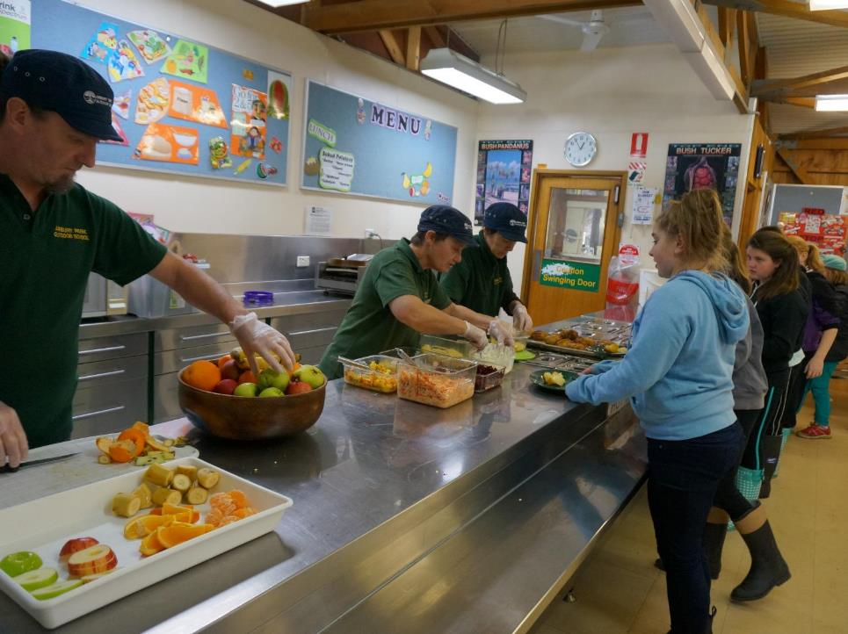

Slide 9
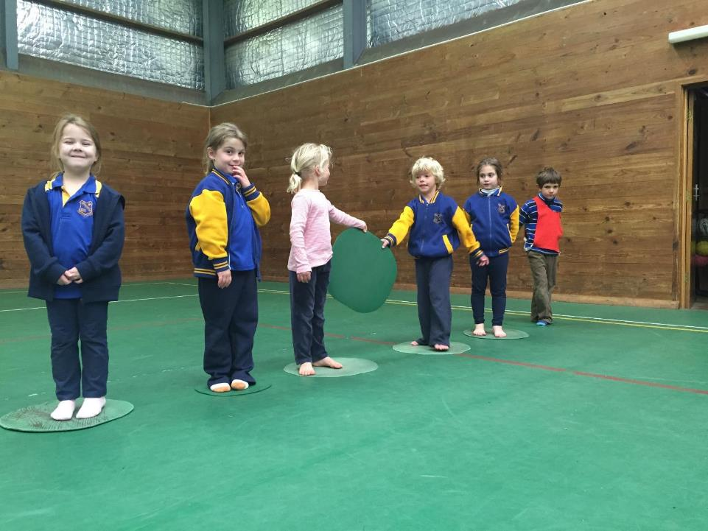
A large gym caters for day and night activities.

Slide 10
Curriculum
Arbury Park Outdoor School curriculum can be divided into six themes. Grouping the learning activities in this way can help teachers match activities with their camp priorities.
Exploring ecology | Animal survival, Bird ecology, Nature’s recyclers, Freshwater life, Catchment walk, Hidden world, Looking for evidence, Web of life game
Taking action | Bushcare, Landcare, Nesting boxes, Bee hotel, Plant propagation
Group development | Cooperation games, Team challenge, Shelter building, Mission possible, Bush survival
Creativity and imagination | Appy Arbury, Earth art, Earth walk, Magic spot
Outdoor recreation | Campfire cooking, Hiking, Maps and symbols, Orienteering
Aboriginal cultural studies | Including: tools and implements, ochre painting, dreaming stories

Slide 11
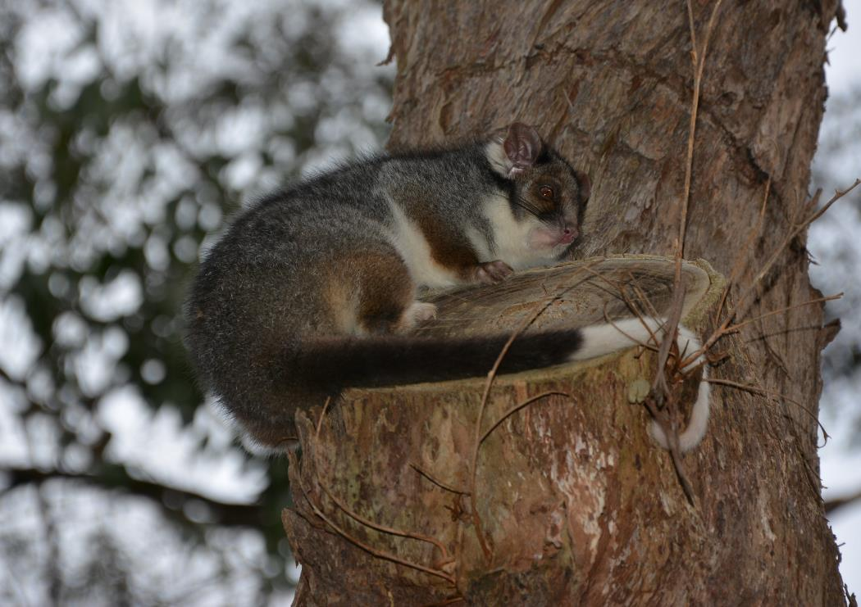
Exploring Ecology

Slide 12
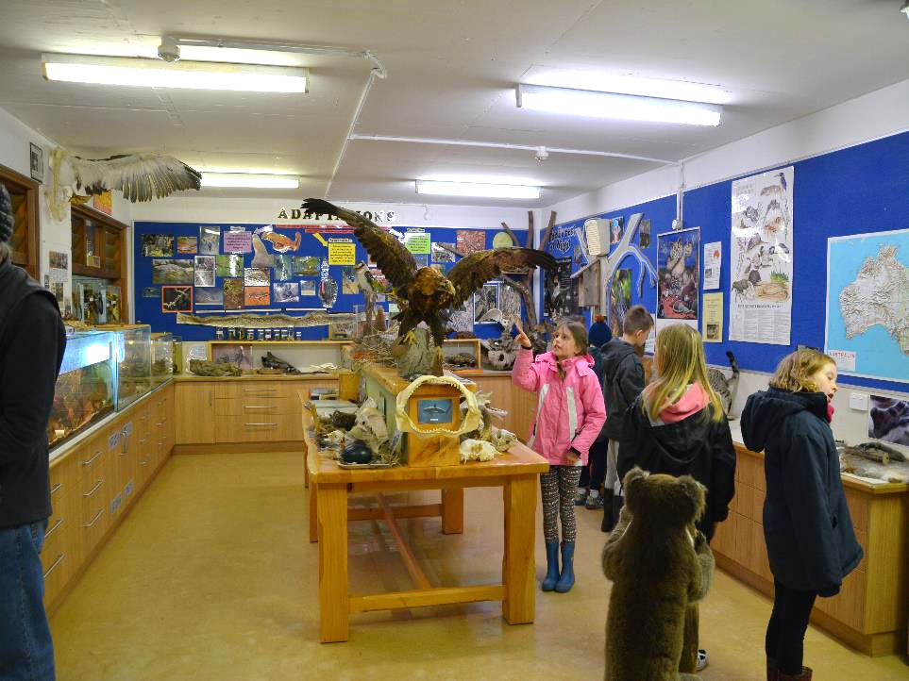
Animal Survival
Students learn about animal adaptations and interrelationships using preserved animals in our Ecocentre.

Slide 13
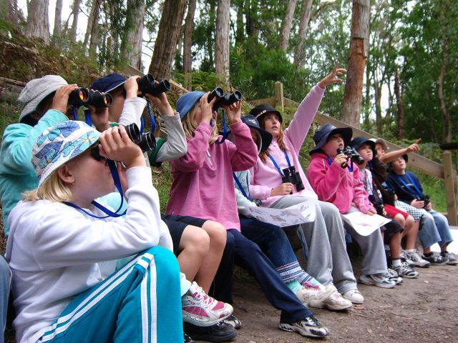
Bird Ecology
Students practise the skills of bird watching and identification. They observe bird behaviour and discuss how different species fit into the overall ecology of different habitats. A collection of stuffed bird specimens allows close examination.

Slide 14
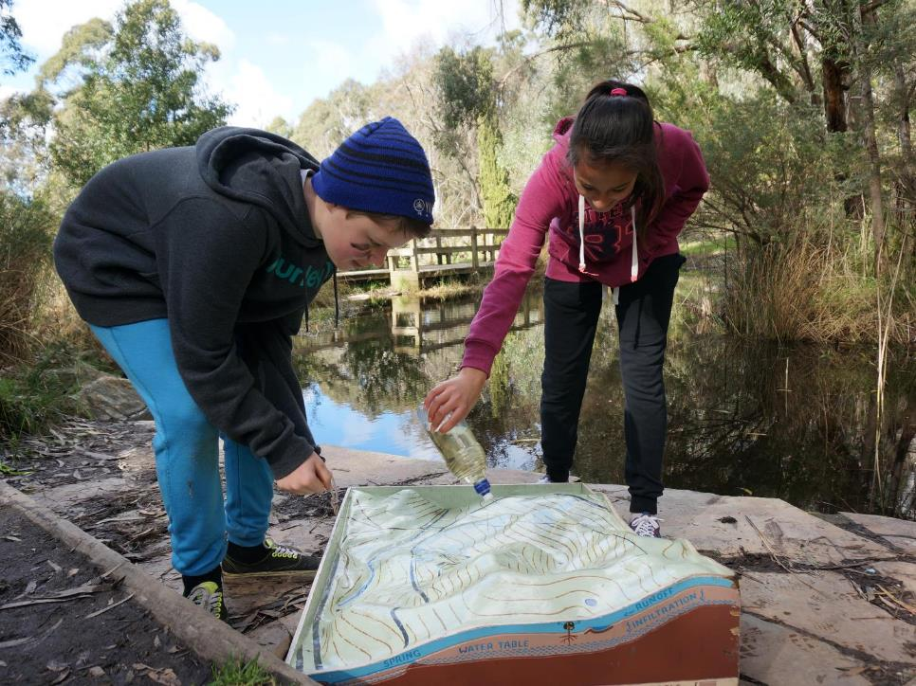
Catchment Walk
With the aid of maps and a 3D model, students walk through the school property to experience the features of a catchment. They explore how land use affects drainage and water quality and compare this to their local catchment.

Slide 15
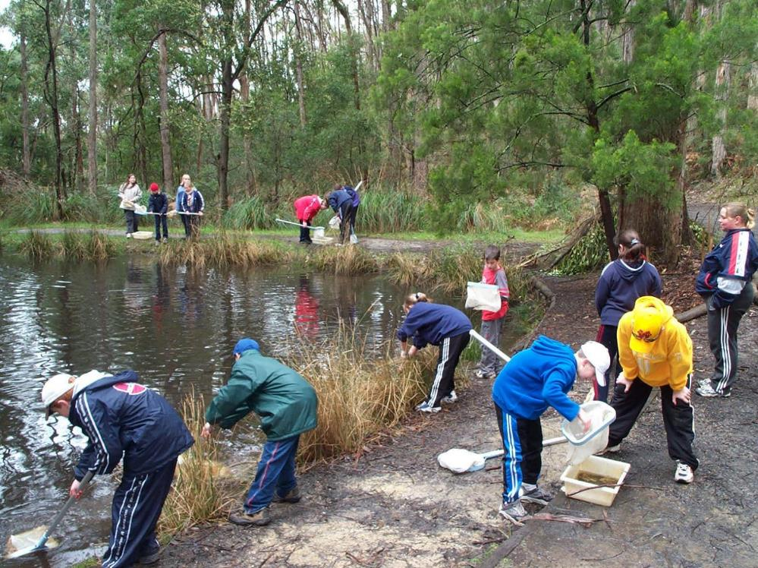
Freshwater Life
Students collect samples of invertebrates using nets and observe them using magnifiers, microscopes and video camera. They explore feeding relationships, adaptations for survival or habitat requirements of freshwater life.

Slide 16
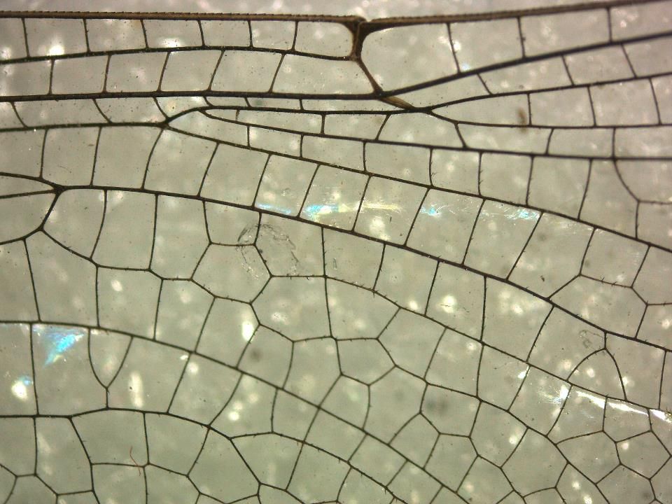
Hidden world
Students explore a ‘hidden world’, so small that is normally invisible to the naked eye. They collect samples from the local environment to look at under microscopes.

Slide 17
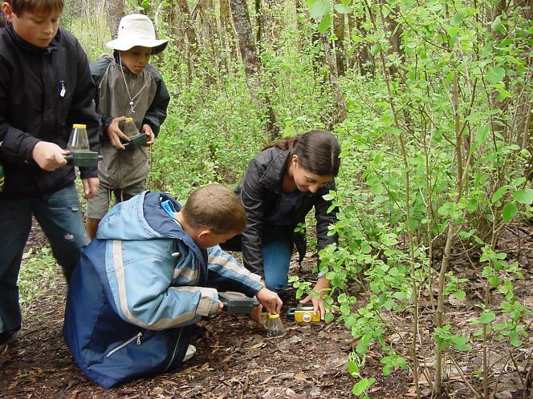
Nature’s Recyclers Students look for fungi and leaf litter invertebrates and observe them using magnifiers and microscopes.

Slide 18
Looking for evidence
Students become ‘bush detectives’ as they search for evidence of animal life in the stringybark forest.

Slide 19
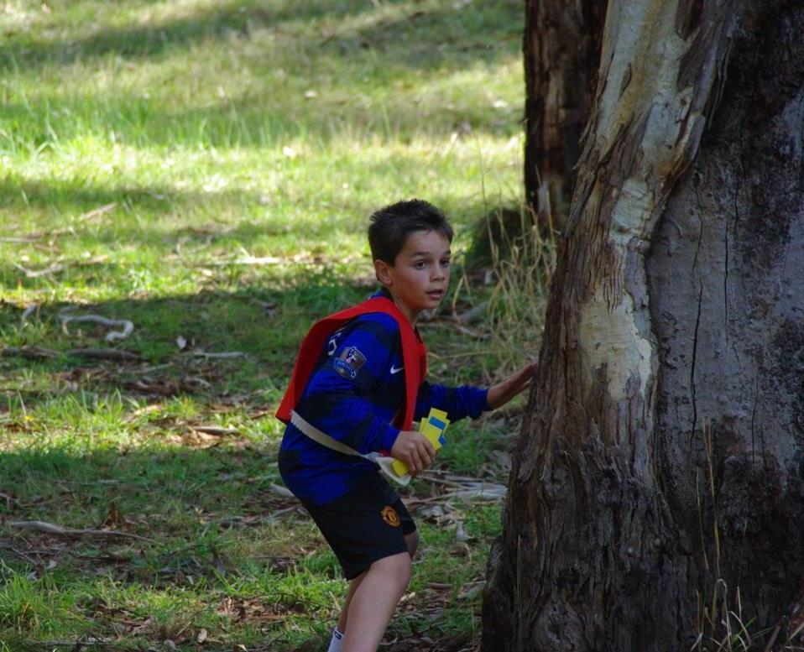
Web of Life game
A simulation game in which students play the roles of predator and prey animals. To survive they must locate water and food that is hidden in an open woodland habitat, and avoid being eaten by a predator!

Slide 20
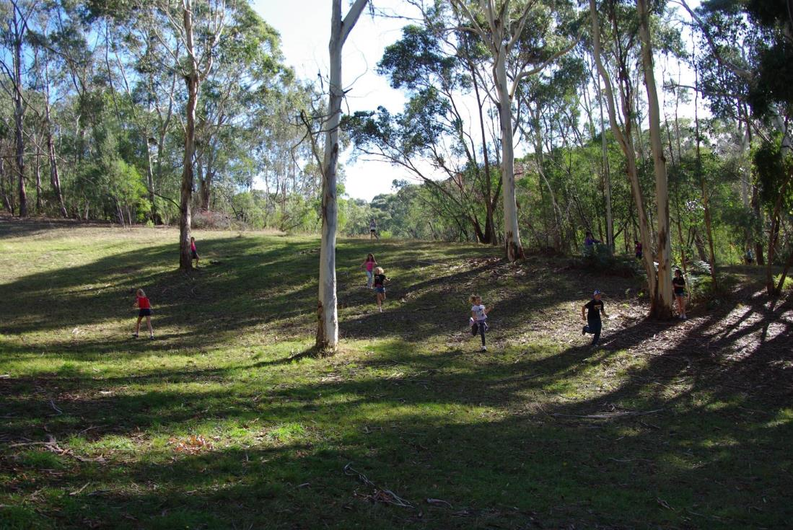
Web of Life game area

Slide 21
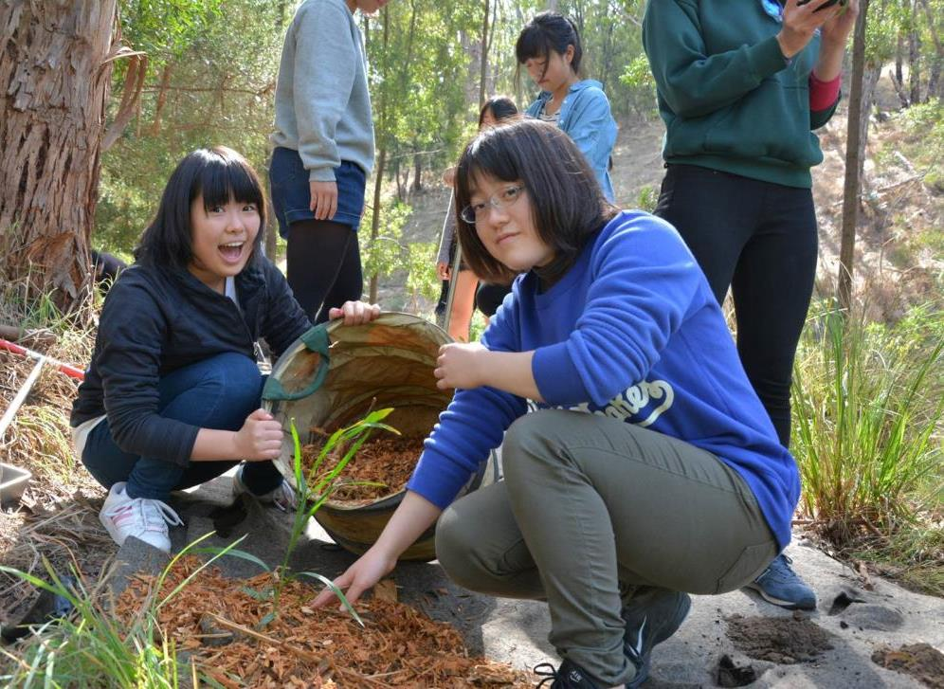
Taking action

Slide 22
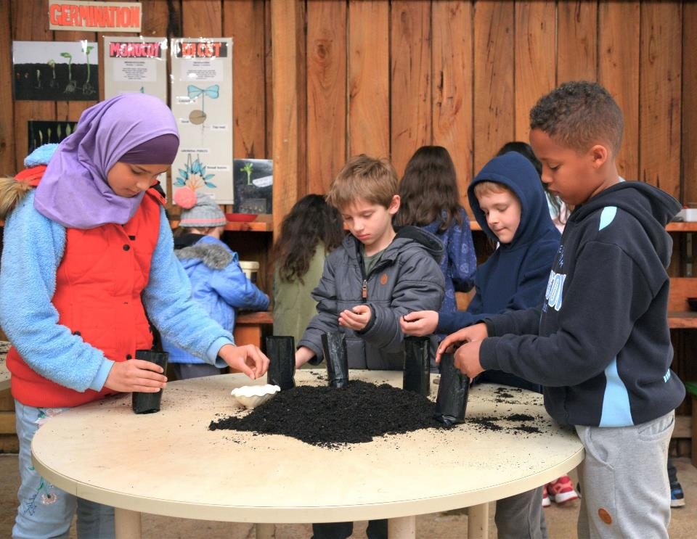
Plant Propagation
In the school's plant nursery, students learn basic nursery procedure to propagate local species from seed. This follows an exploration of flowering plant reproduction and diversity, including flowers, seeds, seed "containers", and survival features of local plant groups.

Slide 23
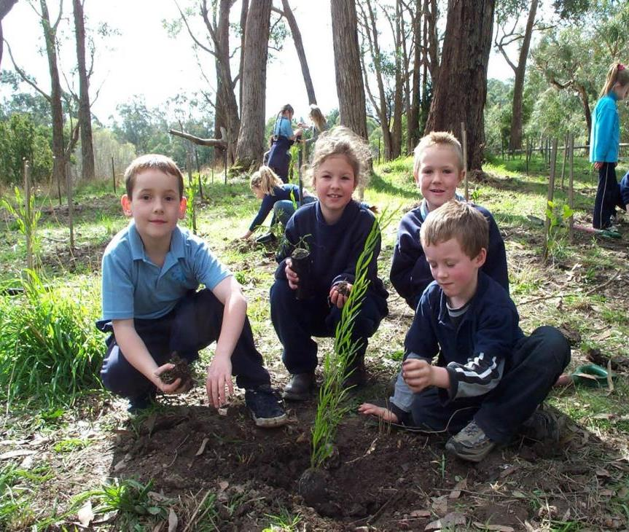
Landcare / Bushcare Students get their hands dirty working on rehabilitation projects using local species propagated in the school’s nursery. They explore the benefits of regeneration and caring for remnant bushland.

Slide 24
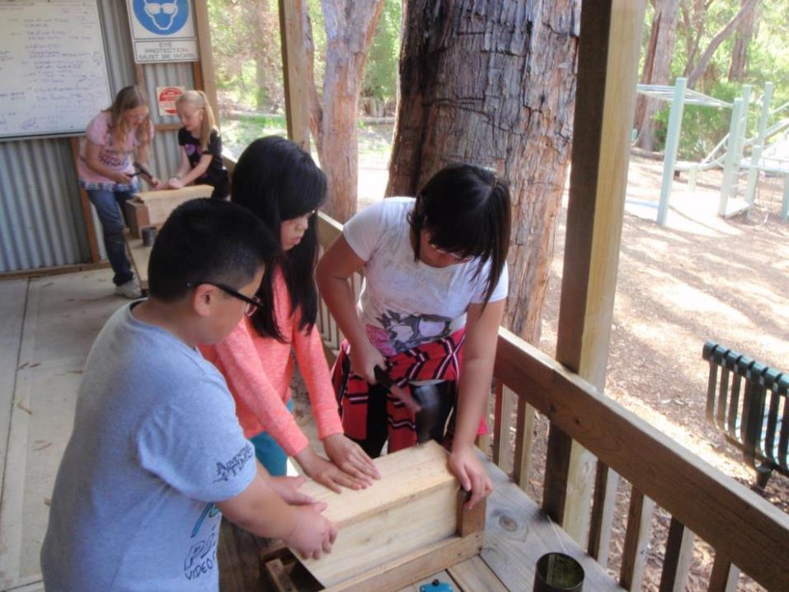
Nesting Boxes Teams of students follow safe work practices to cut and assemble wooden nesting boxes in a specially designed workshop. The procedure includes sawing, drilling and hammering the various components. Students can install completed boxes in their own school as alternatives to lost nesting hollows.

Slide 25
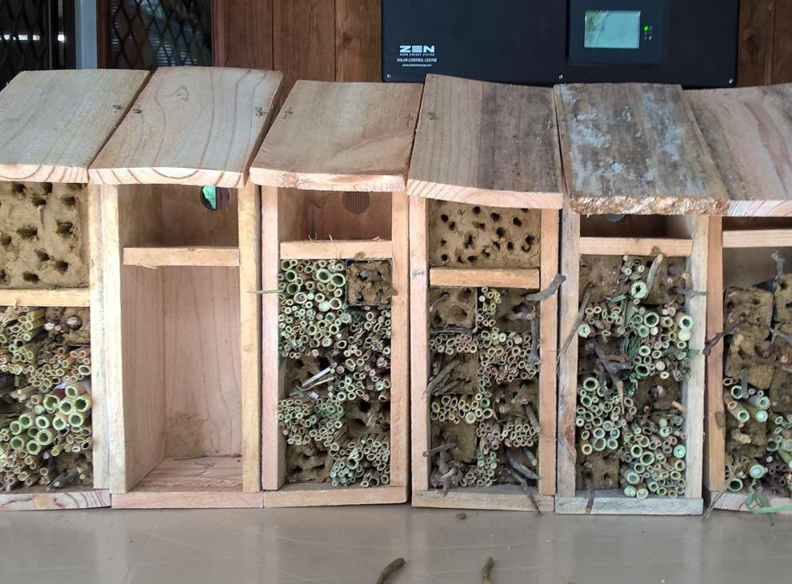
Bee hotels Students create ‘bee bundles’ and ‘bee blocks’ to provide habitat for native bee species. They explore the importance of native bees and the differences between native bees and European honeybees.

Slide 26
Outdoor recreation

Slide 27
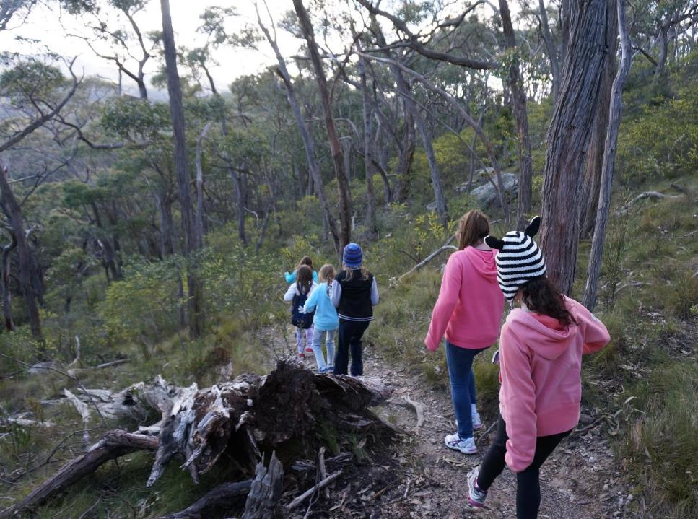
Hiking Hikes include the school boundary, half day circuits of Mt George Conservation Park, an historic loop into the township of Bridgewater, and day hikes along sections of the Heysen Trail. Students learn about preparing for a safe hike.

Slide 28
Orienteering Arbury Park has a number of permanent orienteering courses that use colour, scale orienteering maps. The courses become sequentially more challenging in distance and navigation.

Slide 29
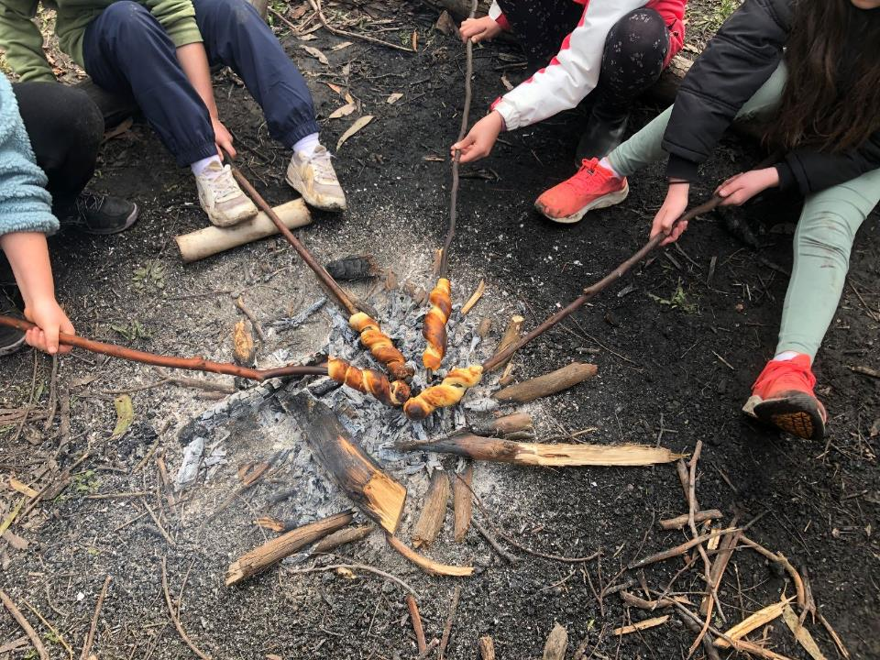
Campfire cooking In groups of three to five, students learn about and create small fires then cook and eat simple camp food.

Slide 30
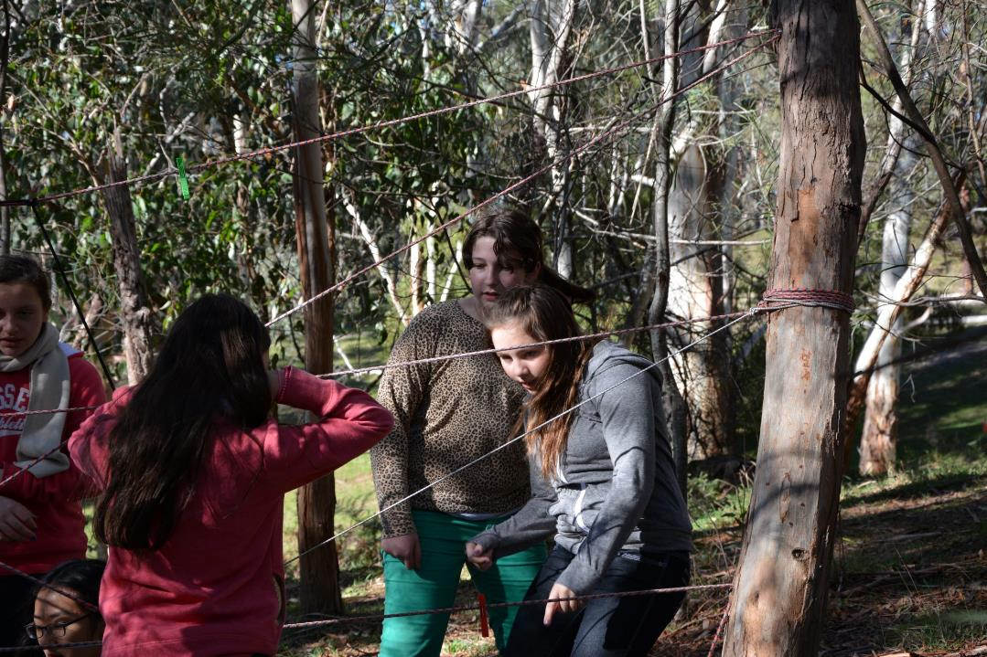
Group development

Slide 31
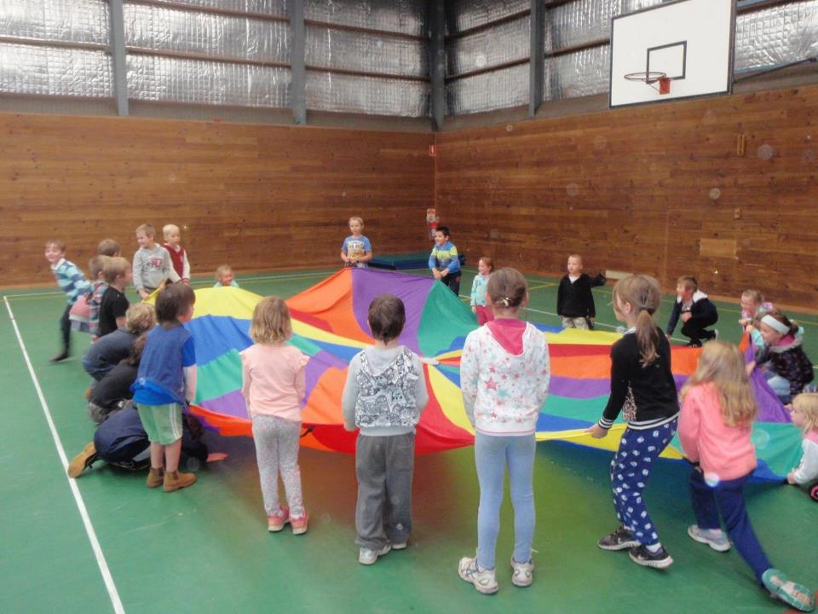
Cooperation Games
Students play a sequence of games that help them learn the skills of cooperation: joining in, listening carefully, talking calmly and including others.

Slide 32
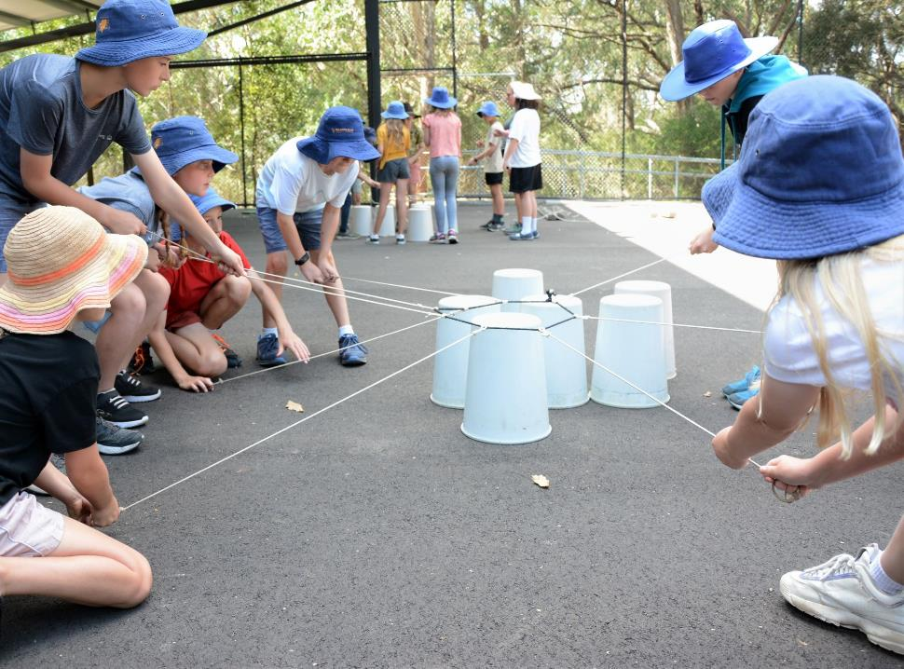
Team Challenge
Students solve group challenges by working cooperatively in small teams. The challenges reinforce the skills of concentrating, persisting, encouraging others, sharing ideas and learning from mistakes.

Slide 33
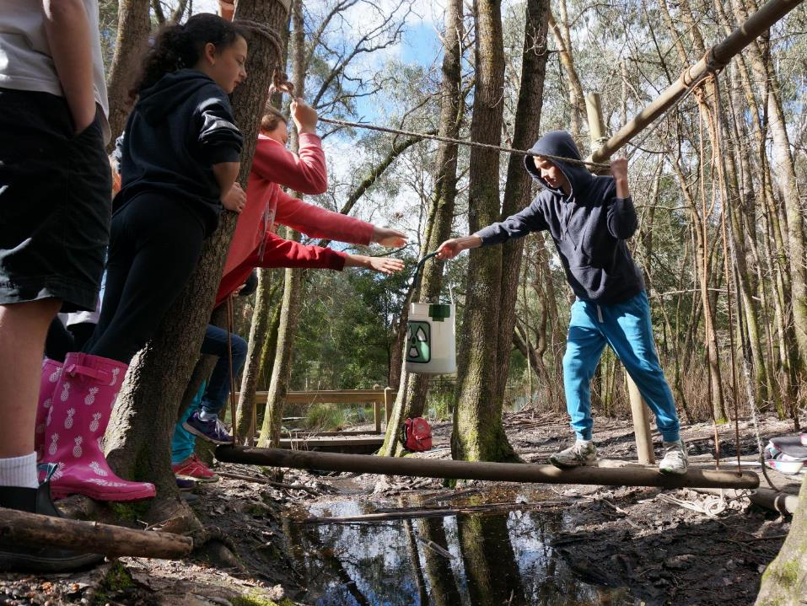
Mission Possible
Following instructions on a secret recorded message, students carry a container of toxic waste through a series of challenges.
To survive this dangerous mission they need all of their communication, thinking and teamwork skills.

Slide 34
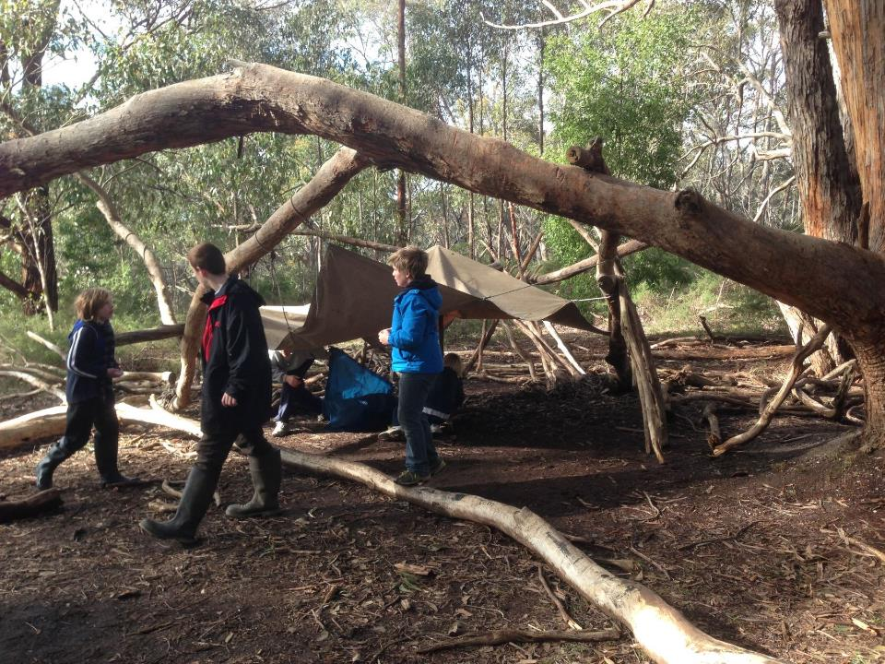
Bush Survival
Students participate in a half-day simulation/role play team survival challenge in a secluded bush setting. They explore their skills in emergency shelter building, simple cooking on an open fire, problem solving and working cooperatively with others.Term 2 and 3 only.

Slide 35
Creativity and imagination

Slide 36
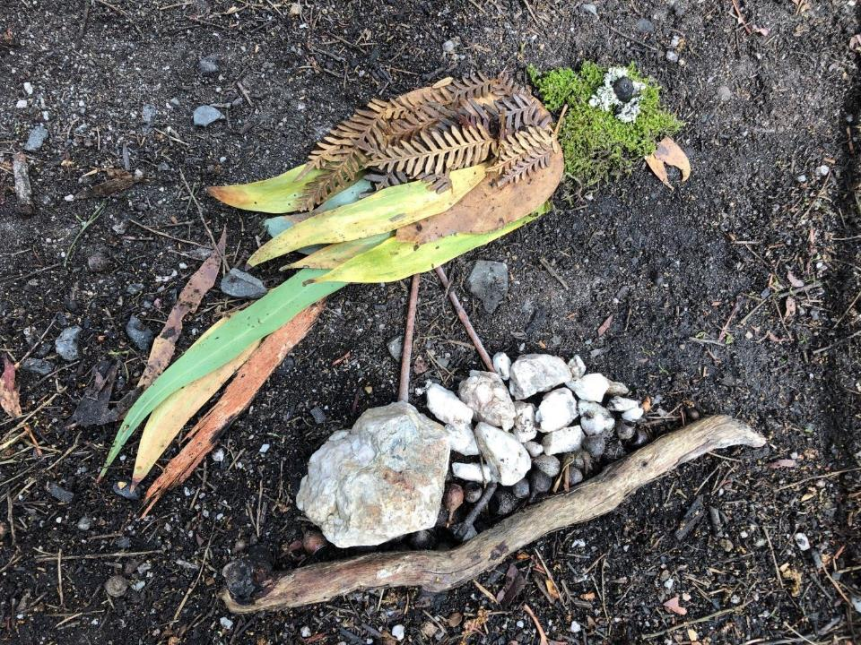
Earth art
Using only earth materials such as leaves, bark, rocks and water, to create art pieces.

Slide 37
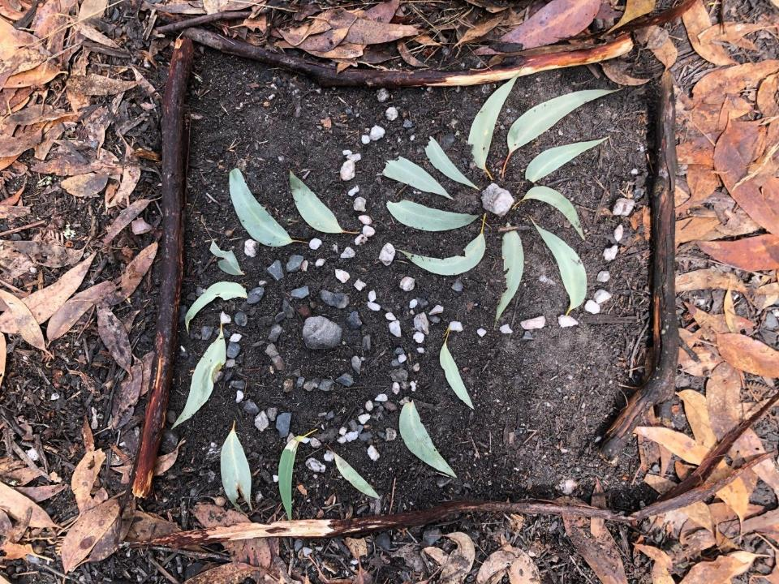

Slide 38
Earth walk
Students engage in a range of short imagination activities and experience the bush using all of their senses.

Slide 39
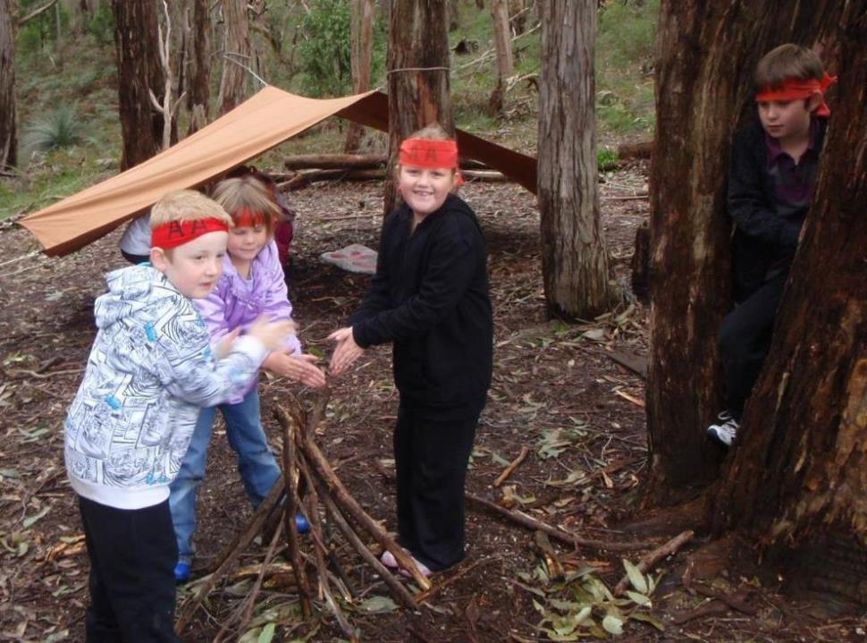
Appy Arbury
A mysterious character "Appy Arbury" lives in the forest. He leaves a trail and recorded message for younger students to follow.

Slide 40
Magic Spot
Sitting alone and silently for a few minutes in their chosen spot, students experience sounds sights and smells of the bush. They have space and time to reflect on their experiences at camp, and their individual connection to the natural world.

Slide 41
Aboriginal Cultural Studies
(Traditional lifestyles)

Slide 42
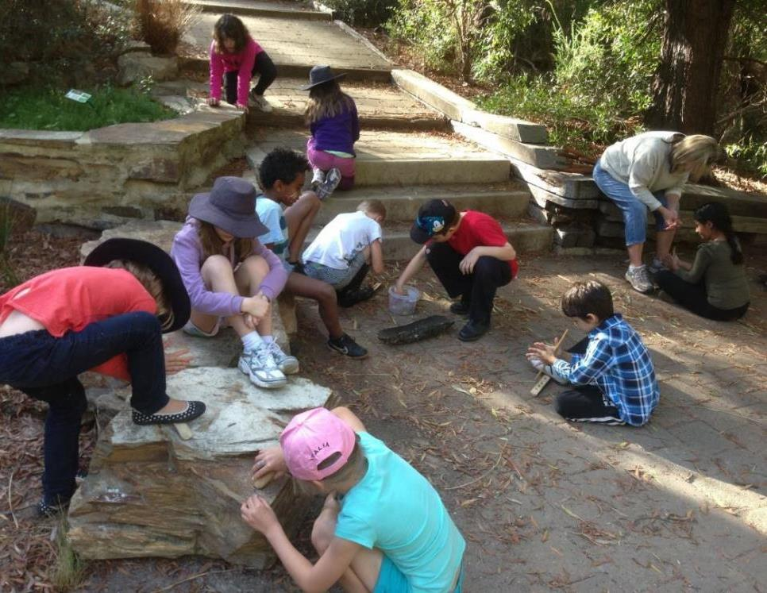
Aboriginal Cultural Studies
Students learn about the traditional lifestyles of Aboriginal peoples through using tools and hearing stories.

Slide 43
ARBURY PARK OUTDOOR SCHOOL
Making connections with our environment
Living and learning together
Bridgewater, South Australia www.arburypark.sa.edu.au

